Slide 1

MVP Presentation
Group
Everyday Friction
Members
Sarah Stantial, Shannon Cullen, Ryan Jankowski, Rohan Pratap Reddy Ravula, Annanahmed Shaikh

Slide 2
Hypothesis
Target User
Young entrepreneurs, business professionals, students, and frequent travelers
Problem
Experience recurring friction with managing cables, adapters, and battery life while on the go.
Solution
This frustration is significant enough that they would pay for an all-in-one universal adapter and charging solution.

Slide 3
Product Concept (adapter + power bank combo)
Concept Overview
An all-in-one adapter + power bank system designed to eliminate the friction of managing cables, plug types, and battery life while on the go.
Core Idea
“One device. Every plug. Always powered.”
A compact, modular charging solution that integrates:
Cable conversion
Power conversion
Portable battery supply

Slide 4
Basic Components
Universal Compatibility
Supports global plug types (US, EU, UK, etc.)
Multi-Device Charging
Up to 8 ports for simultaneous use
5 interchangeable female ports stored within the device
Interchangeable Cable Ends
USB-C base with attachable ends (USB-A, Lightning, etc.)
Built-In Power Bank
Detachable battery for charging without outlets
Retractable & Organized Design
Cables and plugs stored within the device (no loose parts)

Slide 5
MVP Type
MVP Type
A low-fidelity digital prototype (CAD model) was chosen
Purpose
Visualize form, functionality, and component integration for user testing and feedback
Notes:
We developed a CAD-based digital prototype to simulate the physical design and test how users would interact with an all-in-one charging system before investing in manufacturing.

Slide 6
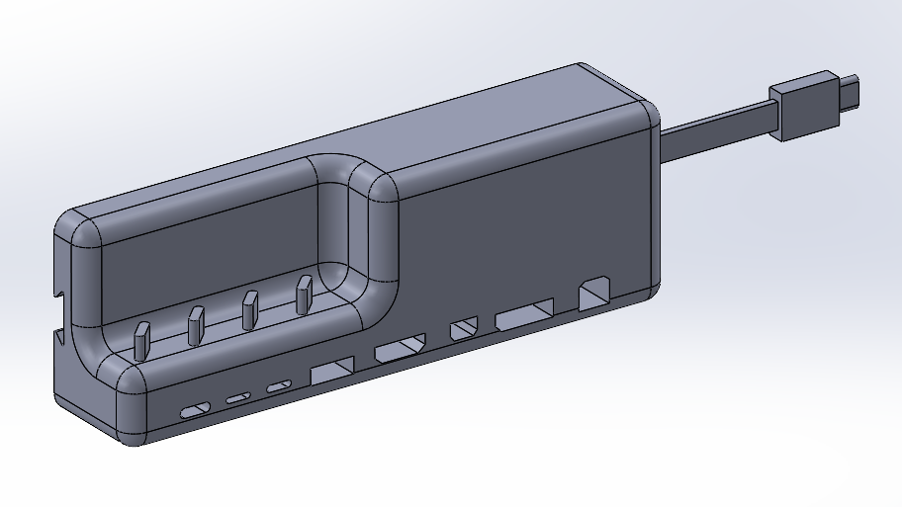
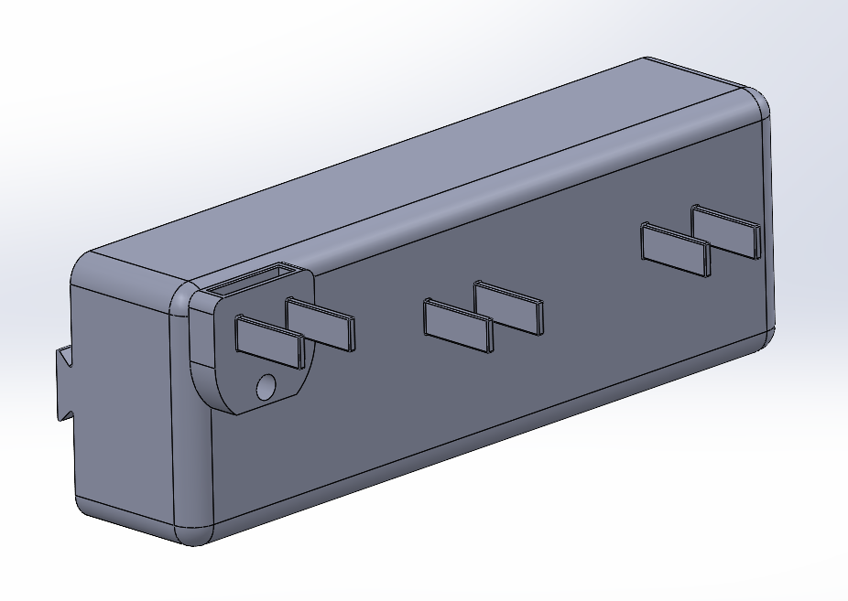
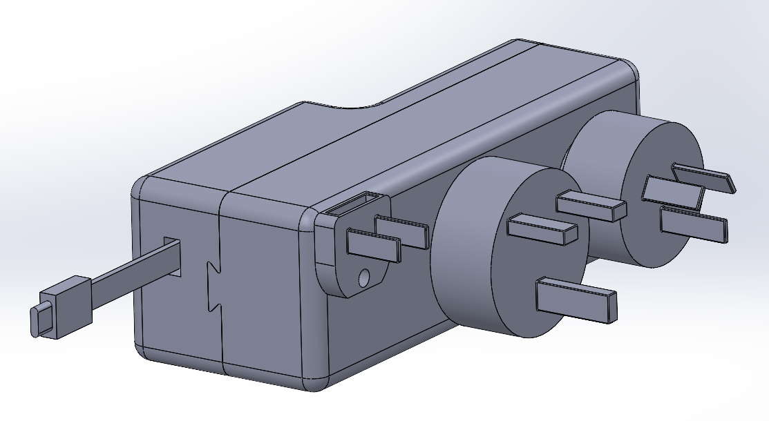
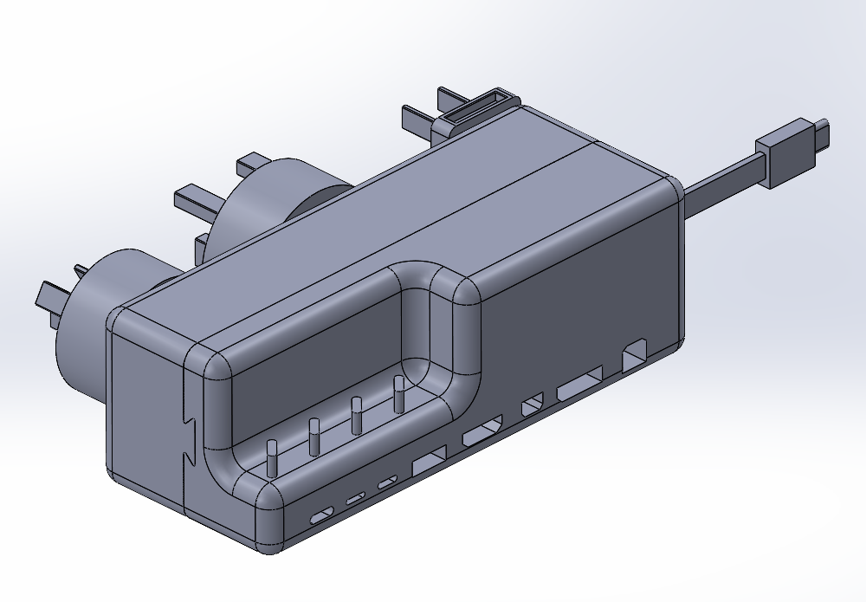
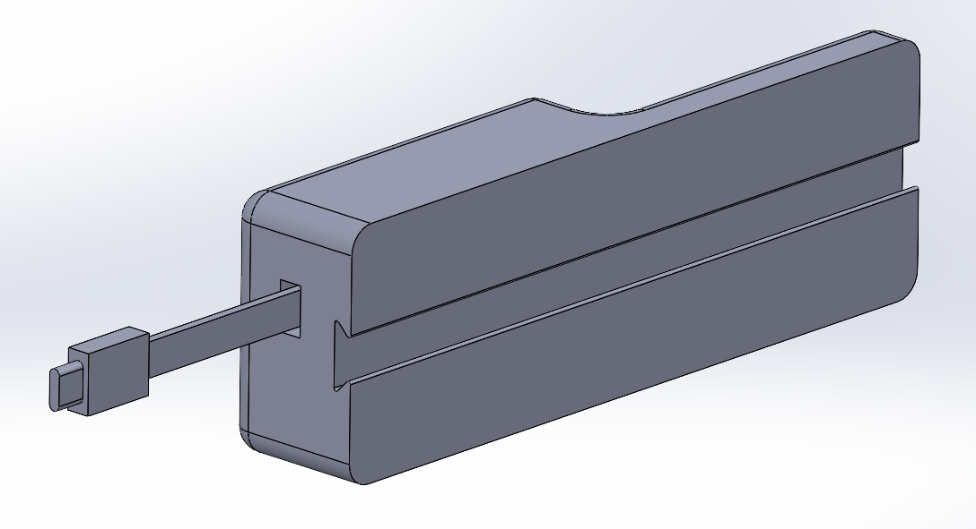
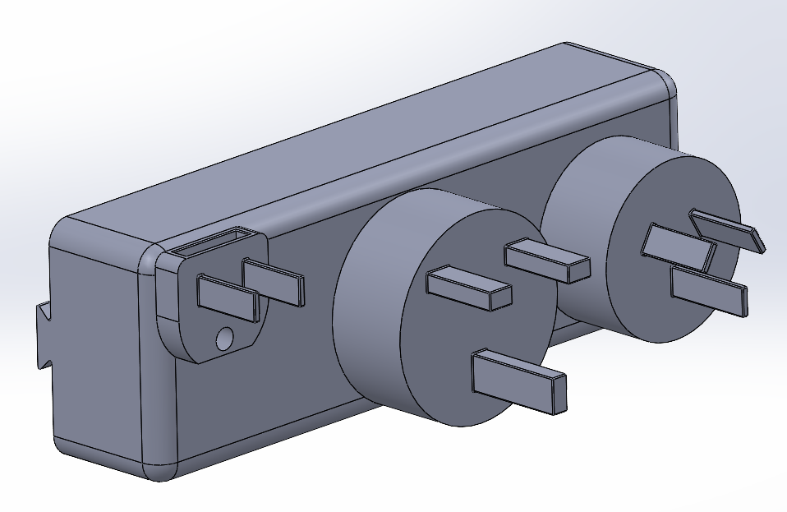
CAD Models
Adapter Part
Battery Part
Full Assembly
Notes:
We developed a CAD-based digital prototype to simulate the physical design and test how users would interact with an all-in-one charging system before investing in manufacturing.

Slide 7
Dimensions
Length – 150 mm (~5.9 in)
Height – 50 mm (~2 in)
Adaptor width – 30 mm (~1.2 in)
Battery width not including plugs – 30 mm
Battery width including plugs – 77 mm (~3 in)

Slide 8
Real-world Value
Eliminating Everyday Friction
Removes the need to carry multiple chargers, adapters, and cables
Time & Convenience
One device replaces 5+ essential charging items
Faster setup, no searching, untangling, or switching adapters
Reliability & Preparedness
Ensures users stay powered in critical moments (travel, meetings, emergencies)
Cost Efficiency Over Time
Replaces the need to purchase multiple adapters and chargers
Reduces loss/replacement costs from forgotten or misplaced accessories

Slide 9
High-level Manufacturing Flow
Design Finalization
Refine CAD model into production-ready design
Component Sourcing
Identify suppliers
Prototyping & Testing
Develop physical prototype from CAD design
Manufacturing & Assembly
Injection molding for outer casing
PCB fabrication, electronics, and internal wiring assembly
Integration of battery, adapters, and cable systems
Quality Control
Functional testing of every unit
Packaging & Distribution
Retail and e-commerce readiness

Slide 10
Rough Cost Assumptions
Rough Cost Assumptions
Component | Estimated Cost
Battery Pack (Li-ion) | $10 – $15
PCB & Electronics | $8 – $15
Adapter Modules (US/EU/UK etc.) | $6 – $10
Cables & Connectors | $3 – $5
Outer Casing (molded) | $6 – $8
Assembly & Labor | $5 – $8
Packaging | $1 – $2
Total Estimated Cost | $40 – $65
Target Pricing Strategy
Expected retail price: $99 – $129
Gross margin: ~50 – 58%
Positioned as a premium, all-in-one solution
Notes:
Our cost assumptions are based on industry BOM benchmarks, PCB manufacturing data, and injection molding cost structures. While these are not supplier quotes, they are consistent with real-world consumer electronics production ranges.
Different reports define the market slightly differently, but across sources, the travel adapter market consistently falls between roughly $1–2.5 billion

Slide 11
Timeline
Phase 1, 2, and 3: Complete
Phase 4: User Feedback & Testing (Week 4–5)
Presented concept to target users
Collected feedback on usability, need, and interest
Phase 5: Refinement & Next Steps (Week 5+)
Adjusted design based on feedback
Evaluated cost assumptions and manufacturing feasibility
Planned next iteration (physical prototype + deeper testing)

Slide 12
Feedback, Observations, and Key Insights
Throughout the design process...
Guidance from Feedback
Added a battery pack because simply having an adapter did not meet the needs of our target demographic
Needs to eliminate wires and confusion not create more (Integrated wires)
Guidance from Observations
Current MVP needs a more integral design
MVP needs to be slim and in style for todays market
Users are solving for convenience and reliability, not just charging
Key Insights
¾ Testimonials through interviews plus class breakouts showed willingness to pay for this product
Market Estimated at ~$1.1B – $2.4B globally (2025)
Market projected to double in 5 years

Slide 13
Hypothesis Validation
What We Tested
Presented CAD-based MVP to target users
Walked through real-world use scenarios (travel, work, daily use)
Gathered feedback
Key Findings
Majority of users confirmed:
Frequent frustration with cables, adapters, and battery life
Difficulty staying organized and prepared while traveling
Strong interest in a single, all-in-one solution
Notes:
Hypothesis Partially Validated
Problem is clearly real and widespread
Solution is attractive and relevant
Further validation needed on:
Willingness to pay
Optimal design and size

Slide 14
Thank you!
Any Questions?

Slide 15
Appendix
AGS Devices. (2025, July 8). BOM cost in 2025: Calculations + how to reduce it. https://www.agsdevices.com/bom-cost/
3ERP. (n.d.). How much do injection molding costs and how to reduce them. https://www.3erp.com/blog/injection-molding-cost/
PCBCart. (n.d.). How much does PCB assembly cost: A complete guide. https://www.pcbcart.com/article/content/how-much-does-pcb-assembly-cost.html
The Insight Partners. (2024). Travel adapter market report. https://www.theinsightpartners.com/reports/travel-adapter-market
Market Intelo. (2025). Travel adapter market report. https://marketintelo.com/report/travel-adapter-market

